Slide 1



LOOK BACK 3
Part 4

Slide 2
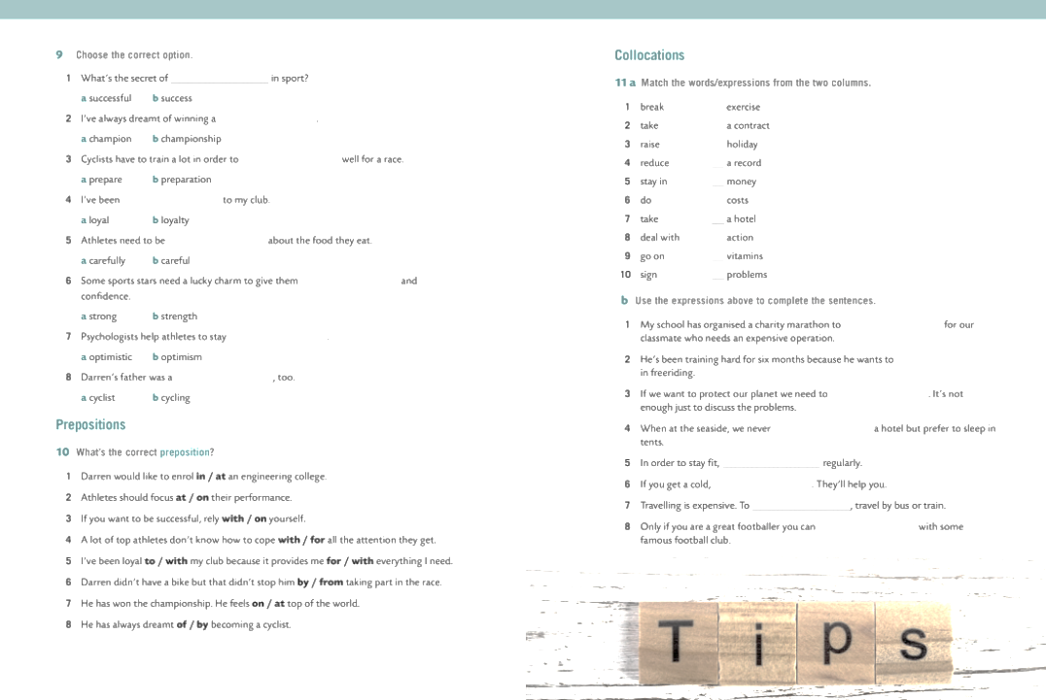
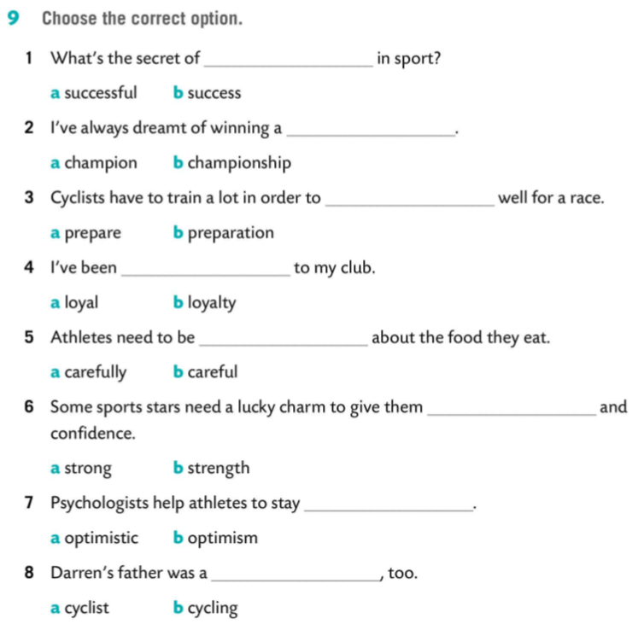


Slide 3
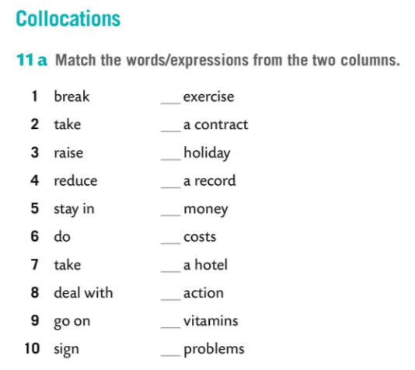
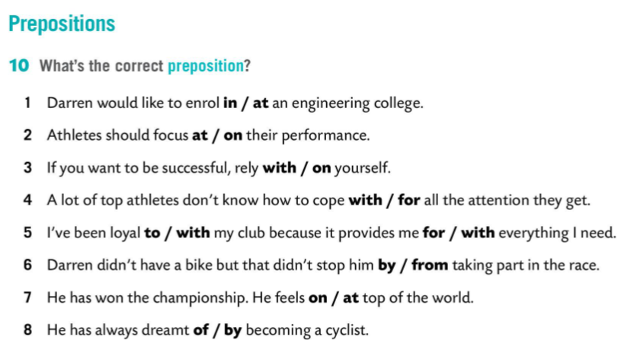
6
10
9
1
3
4
5
2
7
8

Slide 4
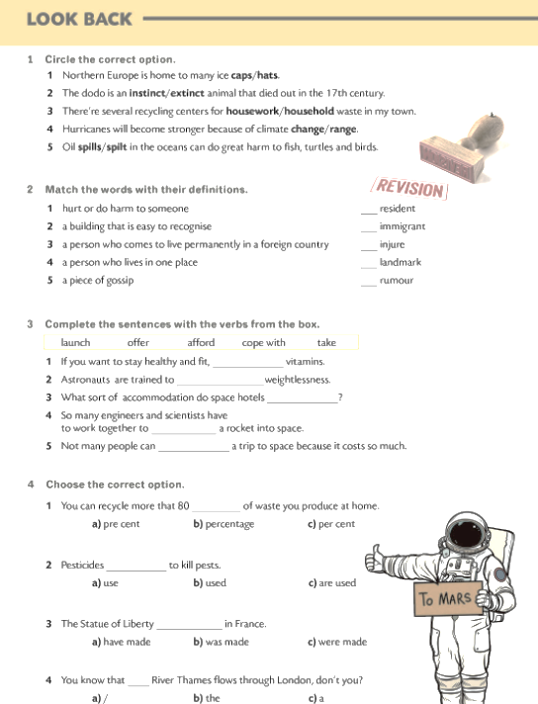
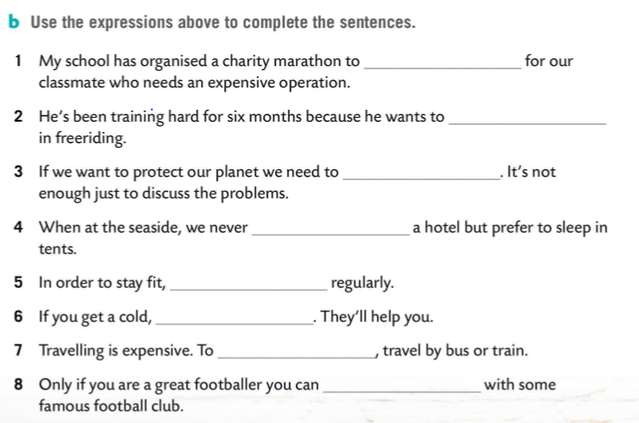
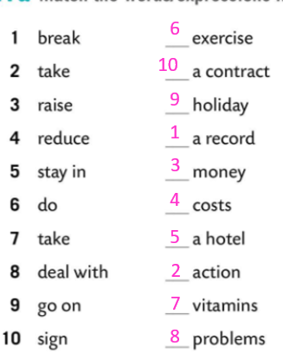
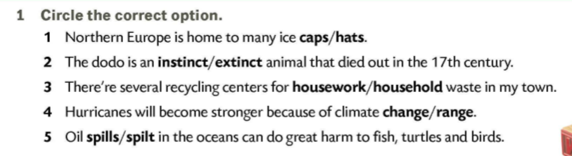
raise money
break a record
take action
stay in a hotel
do exercise
take vitamins
reduce the costs
sign a contract

Slide 5
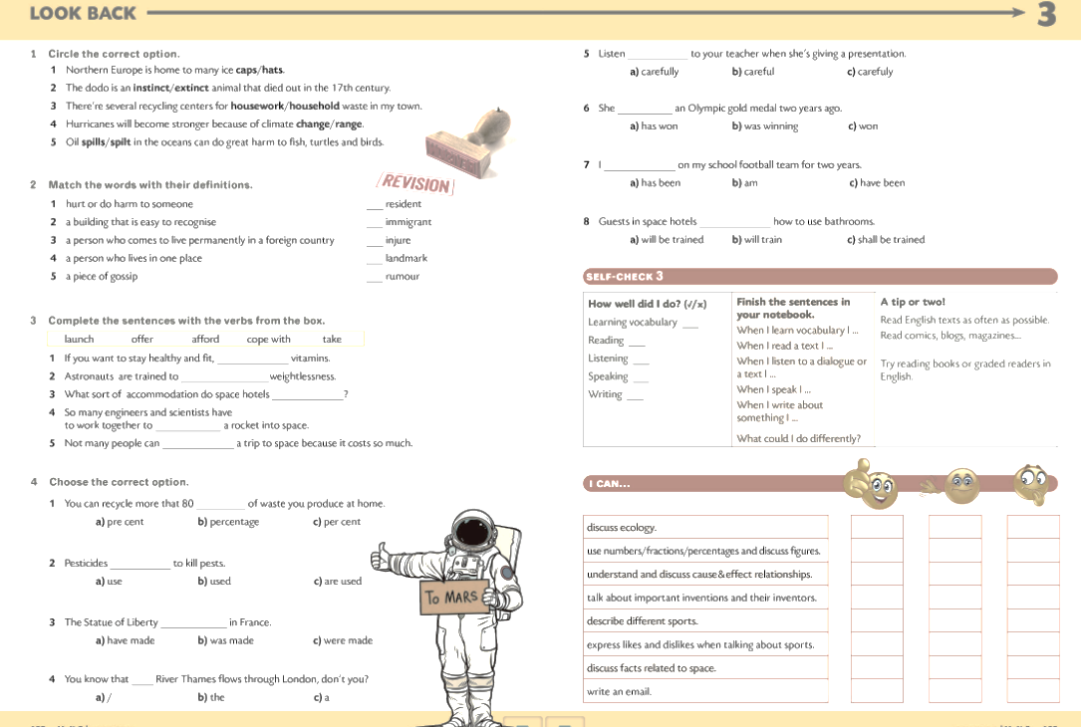


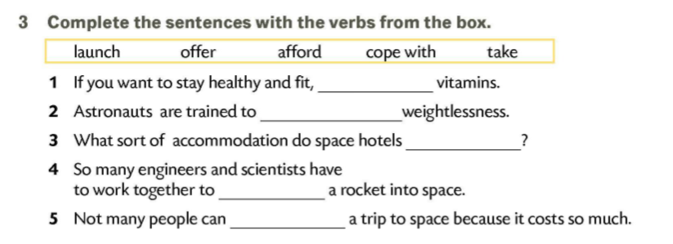
4
3
1
2
5
take
cope with
offer
launch
afford

Slide 6
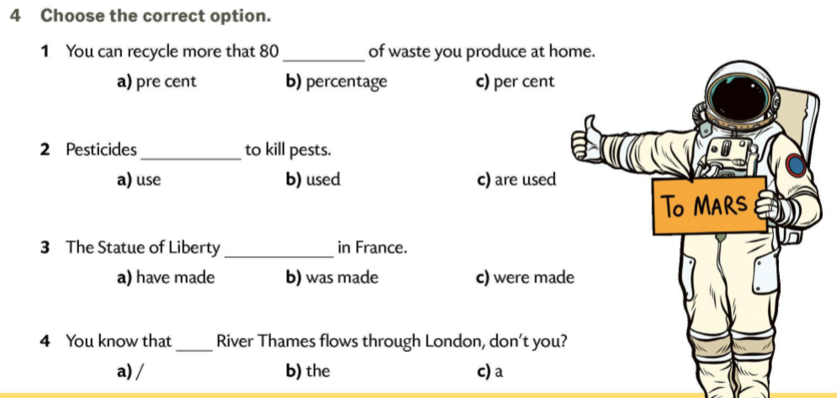
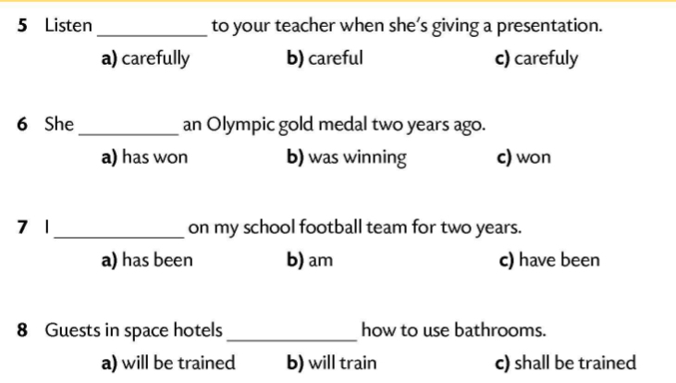

Slide 7
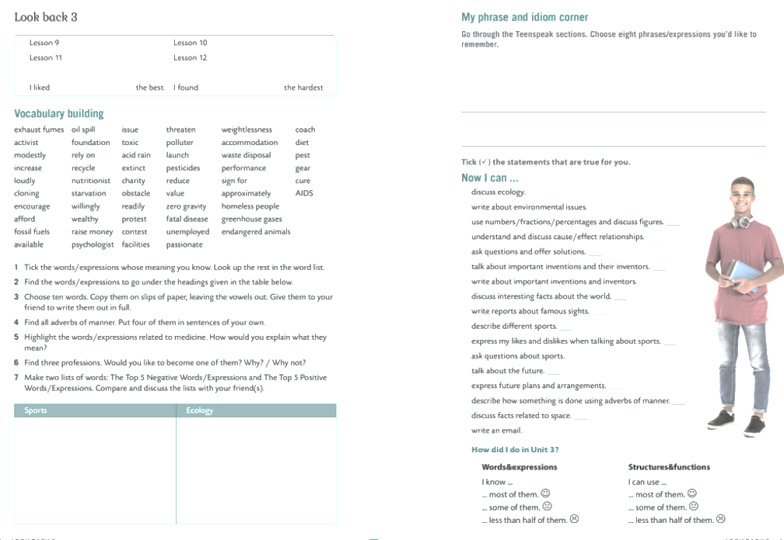
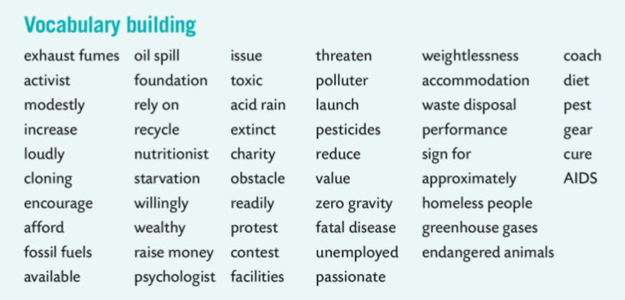

greenhouse gases
reduce
encourage
obstacle
exhaust fumes
activist
nutritionist
fossil fuels
oil spill
recycle
contest
performance
toxic
acid rain
extinct
coach
polluter
pesticides
diet
protest
waste disposal
endangered animals

Slide 8
modestly loudly willingly readily approximately
nutritionist starvation psychologist toxic fatal disease diet AIDS
psychologist coach activist

Slide 9
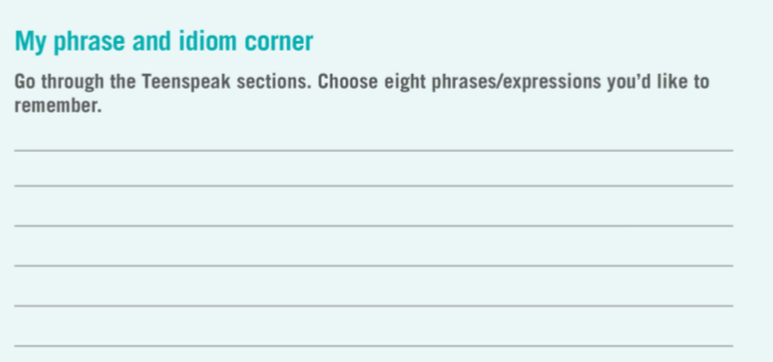
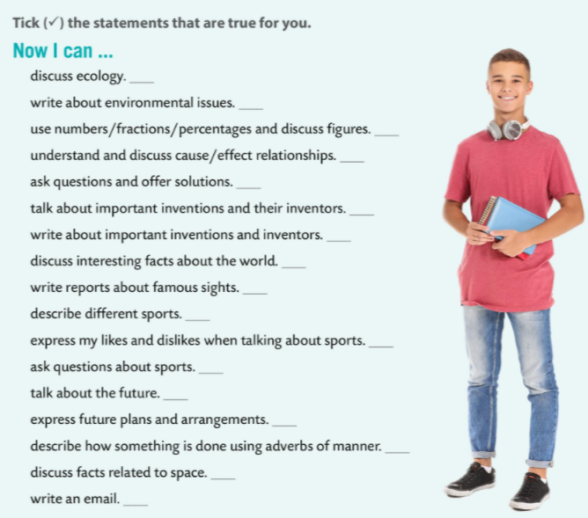
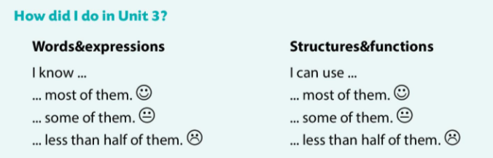

Slide 10

